Slide 1
Database Systems
Lecture 3
Types of databases, Data Models, Schema and Instances

Slide 2
Today’s agenda
Types of Databases
Data Models
Schemas vs. Instances
Database schema vs. Database states

Slide 3
Types of Databases
Centralized Databases
Distributed Databases

Slide 4
Centralized Databases
Personal Computer Database
normally have a single user who creates the database updates and maintains the data and reports and displays
Central Computer Database
users at remote locations can access the database using terminals and data communications links
Client/Server Database
many organizations are downsizing present applications to these smaller, more cost effective computers

Slide 5
Distributed Databases
Homogenous Database
The homogeneous database means that the database technology is the same at each of the locations (or sites) and that the data at various locations are also compatible
Heterogeneous Database
different nodes may have different hardware & software and data structures at various locations are also incompatible.

Slide 6
Data Models
Data Abstraction:
Data Model: A set of concepts to describe the structure of a database, i.e., structure means, the data types, relationships, and constraints that apply to the data.
Data Model Operations: Most data models also include a set of basic operations for specifying retrievals and updates on the database. Operations on the data model may include basic operations (insert, delete, modify) and user-defined operations (compute CGPA).

Slide 7
Categories of data models
Conceptual (high-level, semantic) data models: Provide concepts that are close to the way many users perceive data. (Also called entity-based or object-based data models.)
Physical (low-level, internal) data models: Provide concepts that describe details of how data is stored in the computer, typically magnetic disks
Implementation (representational) data models: Provide concepts that fall between the above two, balancing user views with some computer storage details.

Slide 8
Conceptual Data Model
An entity represents a real-world object or concept, such as an employee or a project, that is described in the database.
An attribute represents some property of interest that further describes an entity, such as the employee's name or salary.
A relationship among two or more entities represents an association among two or more entities, for example, a works-on relationship between an employee and a project.

Slide 9
Physical Data Model
Physical data models describe how data is stored as files in the computer by representing information such as record formats, record orderings, and access paths. An access path is a structure that makes the search for particular database records efficient.

Slide 10
Schemas versus Instances
Database Schema: The description of a database is called database schema which is specified during database design and is not expected to change frequently. It includes descriptions of the database structure and the constraints that should hold on the database.
Schema Diagram: A diagrammatic display of (some aspects of) a database schema.
Schema Construct: We call each object in the schema—such as STUDENT or COURSE—a schema construct.
Database Instance: The actual data stored in a database at a particular moment in time. Also called database state (or occurrence).

Slide 11
Database Schema Vs. Database State
Database State: Refers to the content of a database at a moment in time.
Initial Database State: Refers to the database when it is loaded
Valid State: A state that satisfies the structure and constraints of the database.
Distinction
The database schema changes very infrequently. The database state changes every time the database is updated.
Schema is also called intension, whereas state is called extension of the schema.

Slide 12
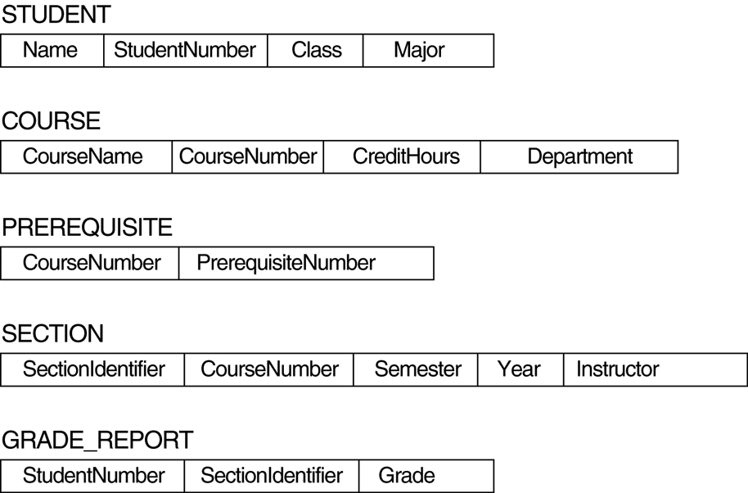
Schema Diagram

